Slide 1



Benefits & Risks in
Stock Market

Slide 2
Table of contents
Introduction………………………………………………………………………………..……...…3
What is Stock Market?...............................................................................4
How Does the Stock Market Work?...........................................................5
Investment & Need of Investment………………………………………………………….8
Benefits in investing Stock Market……………………………………….………………...9
Risks in Stock Market…………………………………………………………………………….12
Different types of Market risks………………………………………….…………………..13

Slide 3
Introduction
Investing in stocks means that you own a piece of a company that you buy a stock in. As the company grows, you can expect the stock to deliver a return on your investment. What are the advantages and disadvantages of investing in the stock market?
Previously, the stock market has delivered generous returns to investors over time, but it also goes down, presenting investors with the possibility of both profits and losses, for risk and return.
The stock market is a collective trading network for company shares and their derivatives. The stock market, also known as the equity market or share market, is a central part of modern economies. It's where companies raise money to expand, pay off debt, or accelerate start-ups. Investors use the stock market to search for returns.

Slide 4
What is Stock Market ?
The stock market is a marketplace where shares of publicly traded companies are bought and sold. It serves as a platform for companies to raise capital and for investors to earn a return on their investment.
Key Components
Stocks: Represent ownership in a company. Owning a stock makes you a shareholder and gives you a claim on a portion of the company's profits.
2. Stock Exchanges: Platforms where stocks are traded. Examples include:
NYSE (New York Stock Exchange)
NASDAQ
BSE (Bombay Stock Exchange) and NSE (National Stock Exchange) in India.
3. Investors: Participants in the stock market who buy and sell stocks. They include:
Retail investors (individuals)
Institutional investors (mutual funds, pension funds, etc.)

Slide 5


Slide 6
How does the Stock Market works?
The stock market works as a centralized platform where buyers and sellers trade stocks of publicly listed companies. Here's a detailed overview of how it operates:
1. The Stock Market Ecosystem
Companies: Businesses that list their shares to raise funds.
Investors: Buyers and sellers of shares, which include retail investors and institutional investors.
Stock Exchanges: Marketplaces like NYSE, NASDAQ, NSE, or BSE where stocks are listed and traded.
Regulators: Authorities like the Securities and Exchange Commission (SEC) in the U.S. or SEBI in India ensure fair trading and protect investor interests.
2. Listing of Companies (IPO)
Companies enter the stock market by issuing shares through an Initial Public Offering (IPO).
The IPO sets the initial share price, and once listed, the shares can be traded on the exchange.
3. Trading Mechanism
Primary Market: Where companies issue new shares directly to investors during IPOs.
Secondary Market: After the IPO, shares are traded among investors in the stock exchange.

Slide 7
Buyer: Places a "buy order" for a certain number of shares at a specific price.
Seller: Places a "sell order" for a specific price.
The stock exchange matches these orders, facilitating the trade.
4. Price Determination
Stock prices fluctuate constantly due to supply and demand dynamics. Key factors influencing prices include:
Company Performance: Earnings reports, revenue, and future growth prospects.
Market Sentiment: General optimism or pessimism among investors.
Economic Conditions: Inflation, interest rates, and GDP growth.
Global Events: Political changes, natural disasters, or pandemics.
5. Role of Brokers
Stockbrokers: Licensed professionals or platforms (like Zerodha, Robinhood, or Fidelity) that facilitate buying and selling on behalf of investors.
They earn through commissions or fees on transactions.
6. Types of Orders
Market Order: Buy/sell immediately at the current price.
Limit Order: Set a price limit for buying or selling.
Stop Loss Order: Automatically sell if the stock drops to a certain price.

Slide 8
7. Stock Indices
Stock indices like the S&P 500, Dow Jones, or Nifty 50 represent the performance of a group of stocks, offering insights into market trends.
8. Investor Returns
Capital Gains: Profit from selling a stock at a higher price.
Dividends: Periodic profit-sharing payments made by companies.
9. Regulatory Framework
Exchanges and transactions are regulated to ensure transparency, fairness, and investor protection.
Rules prevent fraud, insider trading, and manipulation.

Slide 9


Slide 10
Need & Need of Investment
The money you earn is partly spent and the rest is saved for meeting future expenses. Instead of keeping the savings idle you may like to use savings to get a return on it in the future. This is called investment.
One needs to invest to
1. Earn a return on your idle resources.
2. Generate a specified sum of money for a specific goal in life.
3. Make a provision for an uncertain future.
Short Term & Long Term Options for Investment
Short Term :
1. Savings Bank Account
2. Money Market or Liquid Funds
3. Fixed Deposit with Bank
Long Term :
1. Post Office Savings
2. Public Provident Fund
3. Bonds
4. Mutual Fund

Slide 11
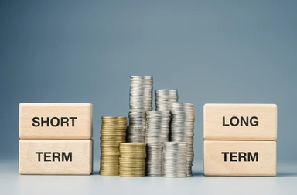

Slide 12
Benefits & Risks in Stock Market
Investing in the stock market is one of the best ways to grow your wealth over time. There are a lot of benefits to investing in the stock market, but it is also important to be aware of the disadvantages. In this article, we will discuss the benefits of stock market investment and help you figure out the right percent of your portfolio that should be invest in stocks. So whether you are thinking of investing for retirement, creating long-term wealth or trying to get ahead on your savings goals, keep reading for all the information you will need.
There are benefits and drawbacks to buying and selling the stock market. It is advantageous to have the possibility for both strong returns and portfolio diversification. However, there is a chance of losing money when investing in the stock market. Because the market can be unpredictable, research is extremely crucial before making an investment. You should be familiar with the fundamentals of financial terms such as price-to-book (P/B), value-to-earnings (V/E), and earnings per share (EPS) in order to make wise selections. You will be prepared to make informed investment decisions after you are familiar with this information.
The growing popularity of stock market investments has people diversifying their portfolios beyond fixed-income assets like FDs. While investing in the stock market has gained traction, some still remain on the fence, given the risks associated with market volatility. However, investors armed with the right knowledge, diligent research, and strategic planning can earn good hedge against inflation, ensuring your investment holds value over time.

Slide 13
Benefits of Investing in the Stock Market
Investors can easily increase their wealth over time through the stock market, which offers chances for both immediate profits and long-term financial stability. The following are some main advantages of stock market investing:
1. Higher Liquidity
Stocks offer relatively higher liquidity than other assets like real estate. Higher liquidity means that it is relatively easy buy and sell stocks due to the presence of multiple buyers and sellers in the market. The high average daily trading volumes of
stocks at the Bombay Stock Exchange (BSE) and National Stock Exchange (NSE) ensure ease of buying and selling for investors. This is one of the chief benefits of investing in the stock market.
2. Versatility
A variety of financial instruments, including shares, bonds, mutual funds, and derivatives, are available for investors to invest in, allowing them to customize their portfolios according to their investment objectives, horizon, and risk tolerance. Each investment's risk can be decreased by diversifying among industries, asset classes, and geographical areas.

Slide 14
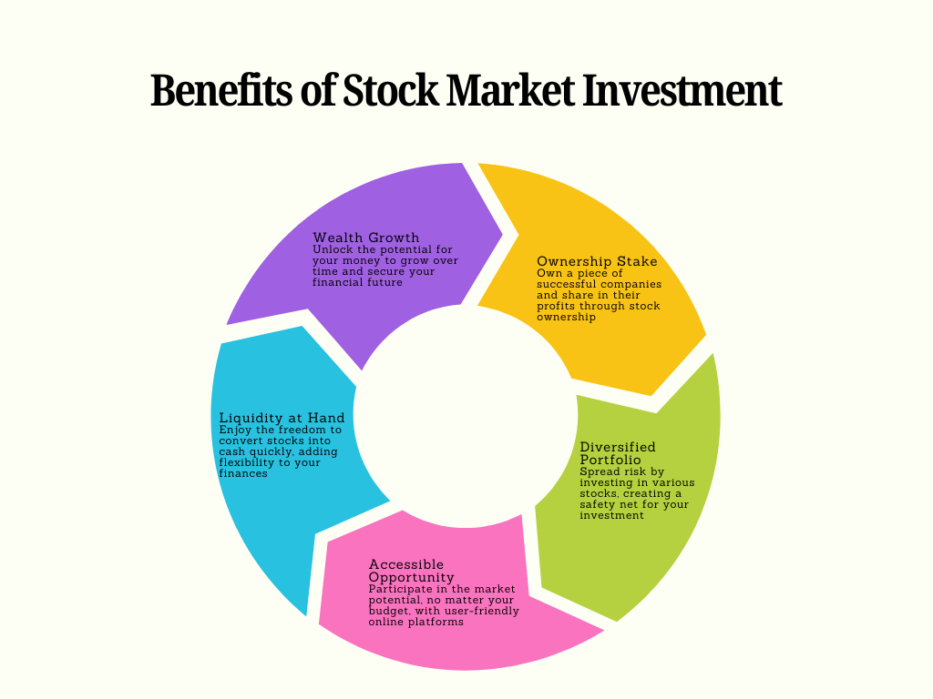

Slide 15
3. Acquire ownership and the right to vote
Investing in the stock market provides investors the unique opportunity to acquire ownership in companies. Owning even a single share of a company makes the investor a shareholder, entitling the individual to an ownership stake in the company. This gives the investor the power to vote on strategic company decisions like approving major business initiatives. Voting rights empower investors to influence the governance and direction of the companies they invest in to best align with their interests.
4. Higher returns in shorter periods of time
One of the main advantages of a stock market is the ability to generate larger short-term returns. Financially responsible investors are drawn to the stock market by the possibility of larger profits in shorter periods of time. Investing in equities can yield significant profits in the near term, although other conventional investment vehicles, such as bank FDs, may take years to produce returns.
Proficient traders who possess a solid understanding of the market and know how to choose stocks for intraday trading can profit from short-term price swings.

Slide 16
5. Dividend Income
Businesses may choose to provide their shareholders dividends from their profits when they turn a profit. Typically, dividends are handed out either regularly or annually. Your dividend income is determined by the stock's dividend yield and the quantity of shares you own. Purchasing dividend stocks entitles you to a portion of the company's profits since you become a shareholder.
In addition to long-term capital growth, dividend income can assist investors in receiving a passive cash flow from their investments.
6. Regulatory environment and framework
The Indian stock market operates under strict regulations to protect investors and maintain the highest level of transparency.
The Securities and Exchange Board of India's (SEBI) regulatory framework governs stock exchange operations, which is one of its main advantages.
SEBI enforces securities laws and regulations and defends investors' rights as a statutory market regulator. For the sake of openness, investor interest protection, and fraud risk mitigation, listed companies must comply with strict regulatory requirements and disclosures.

Slide 17
7. Convenience
The ability to purchase and sell shares with unparalleled ease is one of the primary benefits of stock exchanges. Thanks to digitization, investors can quickly perform trades on an online platform. On an open platform, they can explore investment opportunities and manage their portfolios in real time.
With just a few clicks, investors can begin their investment adventure thanks to the easily accessible online Demat account opening services. Through the consolidation of all assets into a single electronic repository, the Demat account simplifies the investing process and facilitates tracking and monitoring of portfolio performance
Conclusion
There are many benefits for investors in the stock market. Profits from stock market investments can range from short-term gains and portfolio diversification to capital appreciation and dividend income. With plenty of liquidity and the safety net of a regulatory framework, they can use the growth potential of stock market investments to gradually build wealth.
In order to maximize their returns, prudent investors who understand the fundamentals of the market, are aware of market volatility, and are sensitive to thorough research can reduce investing risks.

Slide 18
Risks in Stock Market
Market risk is the chance that a person or other organization will lose money as a result of variables that impact how well financial market investments perform overall. In other words, it is the risk of changes in interest rates and market prices.
The uncertainty involved in any investment choice is referred to as market risk, sometimes called systematic risk. Unexpected changes in variables that frequently impact the whole financial market might lead to price volatility.
Systematic risk depends on the performance of the entire market rather than being particularly linked to the business or sector in which one invests. An investor must therefore monitor a number of macroeconomic variables related to the financial market, including inflation, interest rates, the state of the balance of payments, fiscal deficits, geopolitical events, etc.

Slide 19
Different types of Market Risk
1. Interest rate risk
Interest rate risk in the stock market refers to the potential impact of changes in interest rates on stock prices and the overall value of investments. This risk is particularly relevant because interest rate fluctuations can influence corporate profits, investor behaviour, and economic growth, which in turn affect stock market performance. Here are the key aspects to consider:
a. Relationship Between Interest Rates and Stock Prices
Cost of Borrowing: When interest rates rise, borrowing costs for companies increase, leading to reduced profitability and lower stock valuations.
Discount Rate Effect: Higher interest rates increase the discount rate used in valuation models, reducing the present value of future cash flows and making stocks less attractive.
Competition with Bonds: Rising interest rates make bonds and fixed-income securities more appealing compared to stocks, potentially leading to a shift in investor preference away from equities.
b. Sector-Specific Impacts
Rate-Sensitive Sectors: Certain industries, such as real estate and utilities, are more sensitive to interest rate changes due to their reliance on debt financing.
Financials: Banks and other financial institutions may benefit from rising rates due to improved net interest margins.

Slide 20
c. Economic Influence
Consumer Spending: Higher interest rates can reduce consumer spending by increasing borrowing costs for mortgages, car loans, and credit cards, negatively affecting companies reliant on discretionary spending.
Economic Growth: Rapid increases in rates can slow economic growth, reducing overall corporate earnings and investor confidence.
d. Managing Interest Rate Risk
Diversification: Investors can mitigate interest rate risk by diversifying their portfolios across asset classes, sectors, and geographies.
Defensive Stocks: Investing in defensive sectors, such as healthcare and consumer staples, can provide stability during periods of rising rates.
Hedging Strategies: Use of financial instruments like options, futures, or interest rate swaps can help protect against adverse movements.
Understanding interest rate risk and its implications is essential for both individual investors and companies operating in the stock market. It allows for informed decision-making and better portfolio management.

Slide 21
2. Currency Risk
Currency risk, also known as exchange rate risk, refers to the potential for losses in the stock market due to fluctuations in foreign exchange rates. It primarily affects investors and companies involved in international transactions or those holding investments in foreign markets. Here's how currency risk impacts the stock market.
a. How Currency Risk Works
Currency risk arises when an investor or company deals with assets, revenues, or costs denominated in a foreign currency. Changes in the exchange rate between the home currency and the foreign currency can either increase or decrease the value of those assets or revenues.
Appreciating Home Currency: A stronger home currency reduces the value of foreign earnings or investments when converted back into the home currency.
Depreciating Home Currency: A weaker home currency increases the value of foreign earnings or investments.

Slide 22
b. Key Impacts on the Stock Market
Multinational Corporations: Companies with significant operations overseas are exposed to currency risk. Exchange rate fluctuations can affect their profitability and stock prices. For example:
A stronger home currency reduces the value of revenues earned abroad.
A weaker home currency makes exports cheaper and more competitive globally.
Foreign Investors: Investors purchasing stocks in foreign markets face currency risk because returns depend on both stock performance and exchange rate movements.
Emerging Markets: Emerging market stocks are particularly vulnerable to currency risk, as their currencies are often more volatile and sensitive to global economic trends.
c. Drivers of Currency Risk
Economic Policies: Interest rate changes, inflation rates, and fiscal policies in different countries can cause exchange rates to fluctuate.
Global Events: Political instability, trade wars, and geopolitical conflicts can lead to currency volatility.
Central Bank Actions: Interventions by central banks, such as changing interest rates or currency reserves, can impact exchange rates significantly.

Slide 23
d. Mitigating Currency Risk
Currency-Hedged Investments: Investors can use currency-hedged ETFs or mutual funds to protect against exchange rate fluctuations.
Derivatives: Tools like forward contracts, futures, and options allow investors to lock in exchange rates and minimize risk.
Diversification: Spreading investments across multiple regions and currencies can help offset the impact of adverse currency movements.
Local Investments: Focusing on domestic assets reduces exposure to foreign currency fluctuations.
e. Strategic Considerations
Investors and companies need to account for currency risk as part of their broader risk management strategy. Monitoring global economic conditions and understanding the relationship between currency movements and specific stocks or sectors is crucial for making informed decisions.

